Slide 1



Lifemap
ALPHY – February 1st 2017
Exploring the Entire Tree of Life*
*or any giant tree
Damien M. de Vienne
Laboratoire de Biométrie et Biologie Évolutive
CNRS – Université Lyon 1

Slide 2

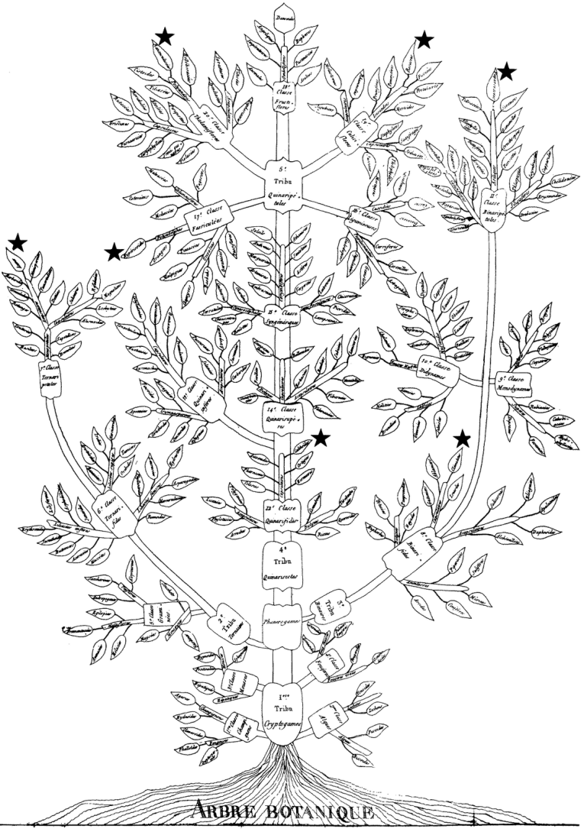
The Tree of Life before Darwin
“I worked for a long time trying to fit families into a continuous series but I found great difficulty… finally I solved it by separating the branches in two and was successful at least at joining them at their bases. At that point I became convinced that plants form different series united at the base, a gradation as that of tree branches”
Plant families
Augustin Augier, 1801

Slide 3
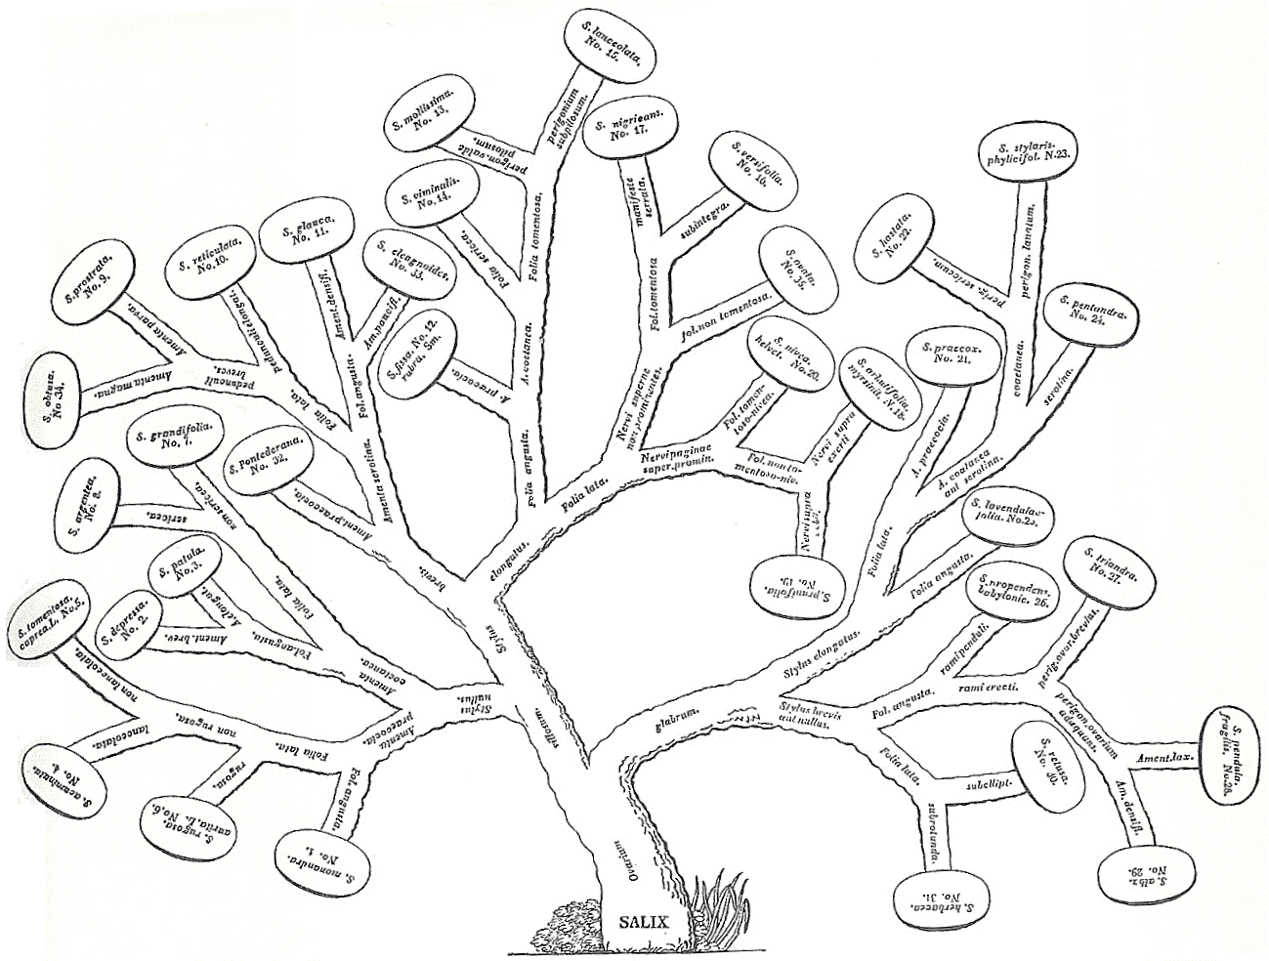
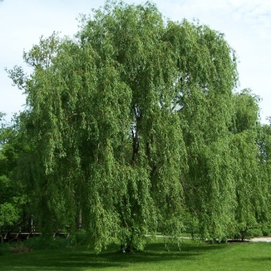
The Tree of Life before Darwin
Willow
Nicolas Charles Seringe, 1815

Slide 4
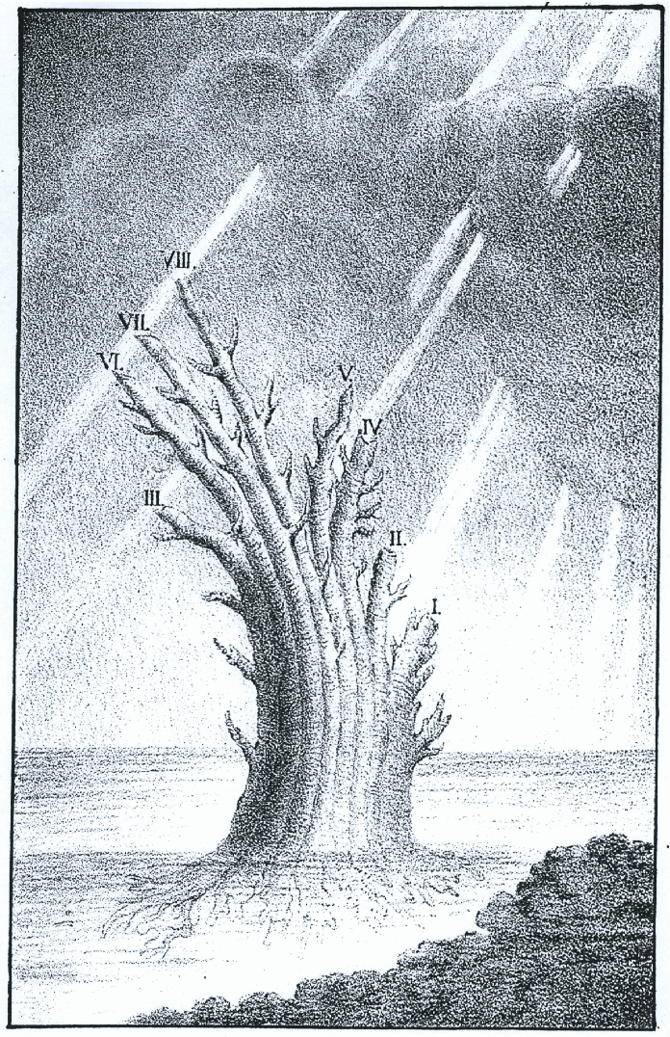
The Tree of Life before Darwin
Animal ‘types’
Eichwald, 1829

Slide 5
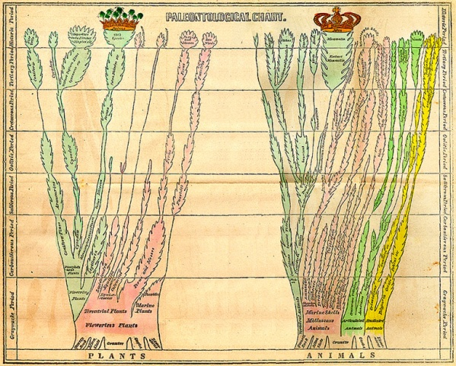
The Tree of Life before Darwin
Fossil times, extinctions, abundance, ‘relationships’
Hitchcock, 1840 (ed. 1852)

Slide 6
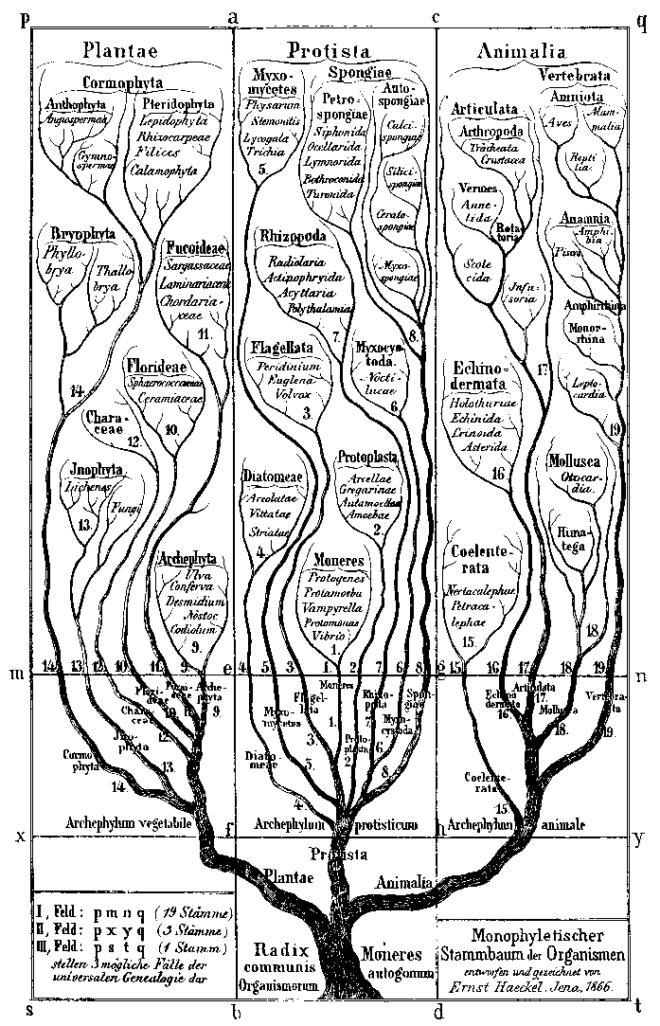
The Tree of Life after Darwin
Haeckel et al., 1866
Animals, plants, protists

Slide 7
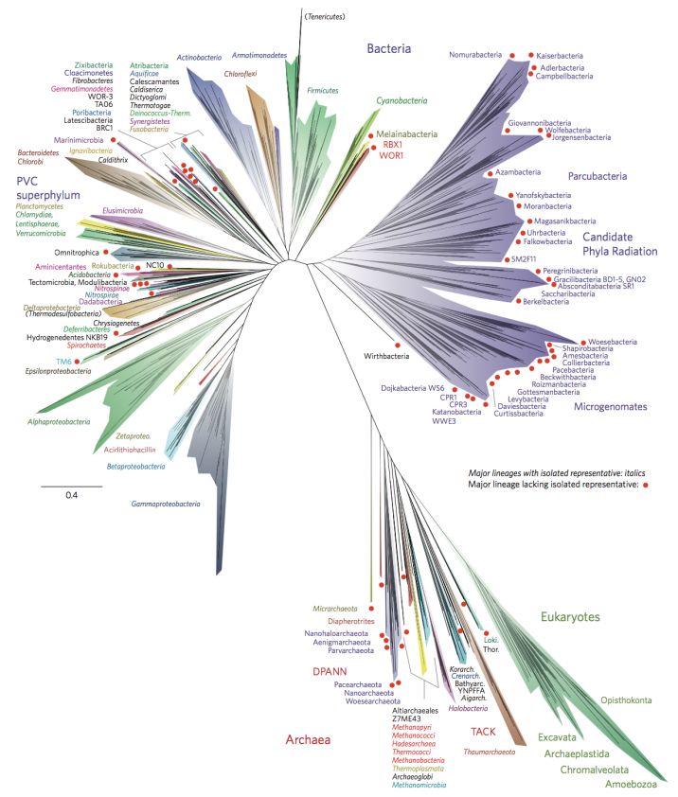
The Tree of Life after Darwin
150 years
Haeckel et al., 1866
Hug et al., 2016

Slide 8
The Tree of Life
Huge efforts to assemble a comprehensive Tree of Life
More sequences
Metagenomics
Improved reconstruction methods
Improved aggregation methods
…

Slide 9
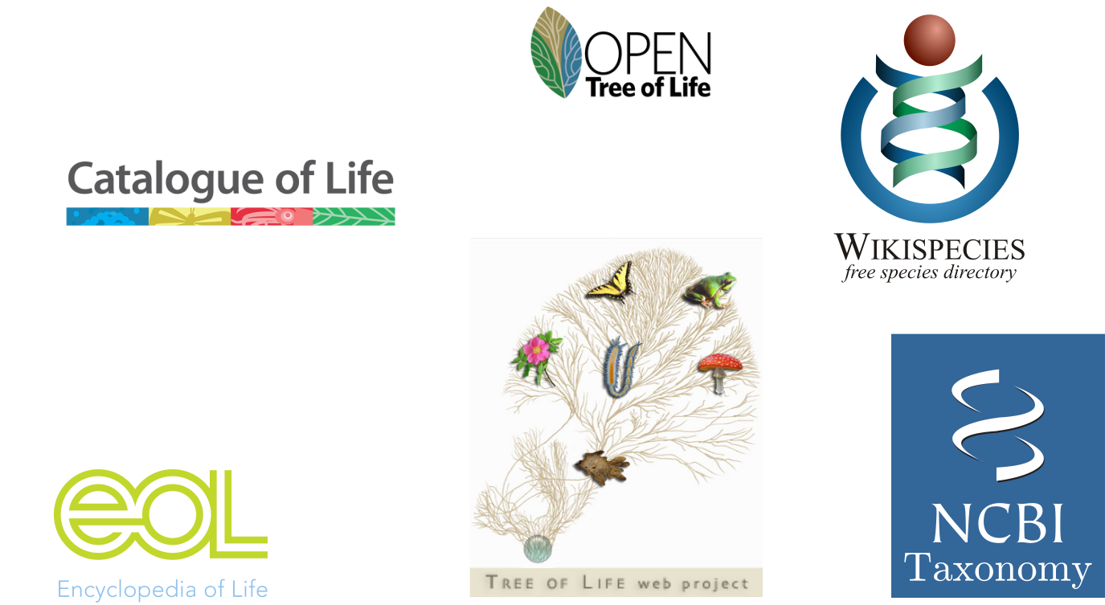

The Tree of Life
Hilnchliff et al., 2015
All-species Living Tree Project by
Yarza et al. 2008, 2010
Wilson, 2003
reviewed in Madisson et al., 2007

Slide 10
The Tree of Life
Hilnchliff et al., 2015
All-species Living Tree Project by
Yarza et al. 2008, 2010
Wilson, 2003
reviewed in Madisson et al., 2007

Slide 11
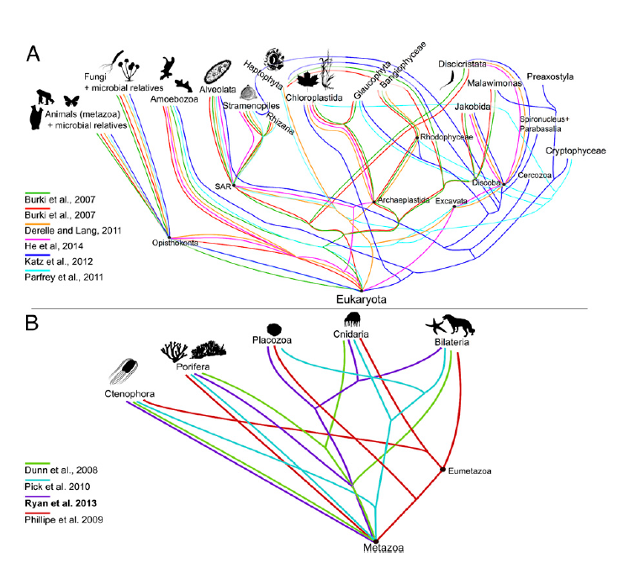
The Tree of Life
Hilnchliff et al., 2015
All-species Living Tree Project by
Yarza et al. 2008, 2010
Wilson, 2003
reviewed in Madisson et al., 2007

Slide 12
The Tree of Life
Huge efforts to assemble a comprehensive Tree of Life…
More sequences
Metagenomics
Improved reconstruction methods
Improved aggregation methods
…
…But almost none to be able to visualize and explore it

Slide 13
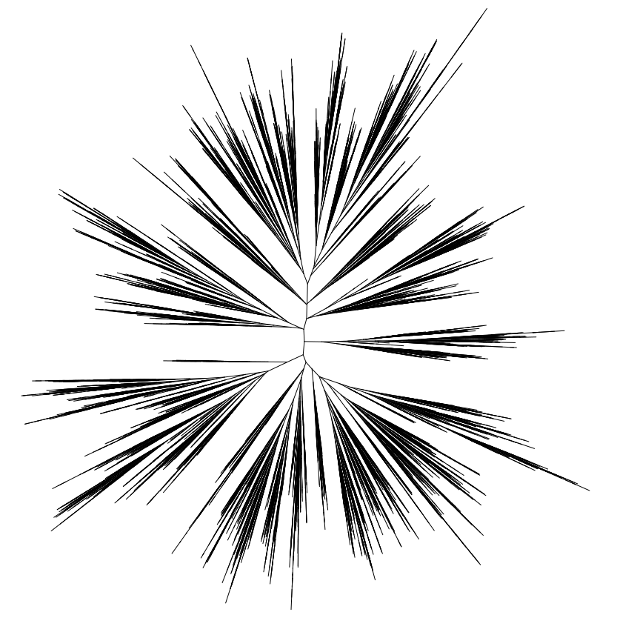
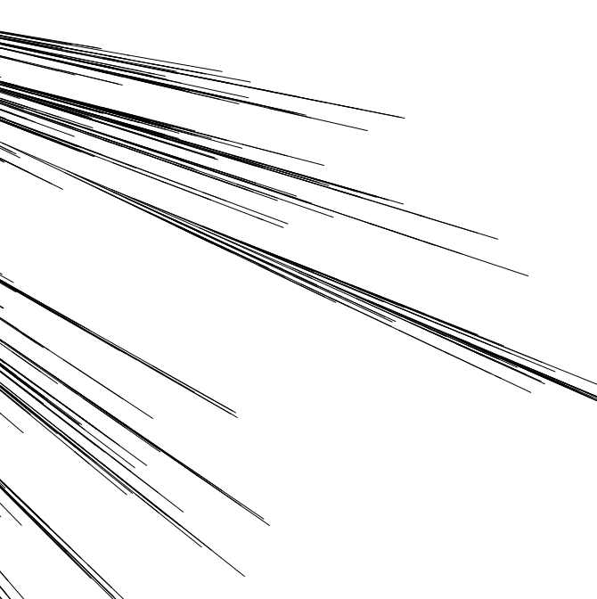
It is difficult to visualize large trees zooming in is not enough
Random tree
10 000 tips

Slide 14

It is difficult to visualize large trees zooming in is not enough
Species x
Random tree
10 000 tips

Slide 15
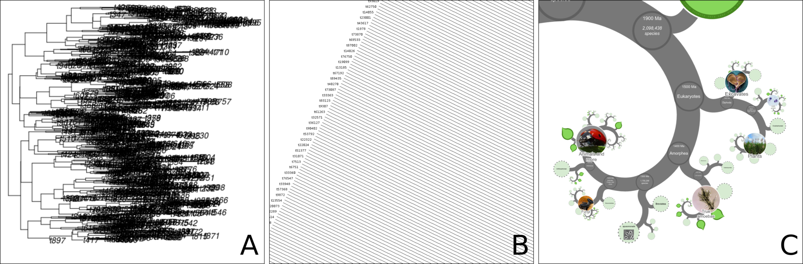
It is difficult to visualize large trees Labels are problematic…
‘ape’ package (Paradis et al. 2004)
Dendroscope (Huson et al. 2007)
Labels overlap
Not interactive
No additional information
No links to external resources
Loss of branching pattern
when labels are visible
No additional information
No links to external resources

Slide 16
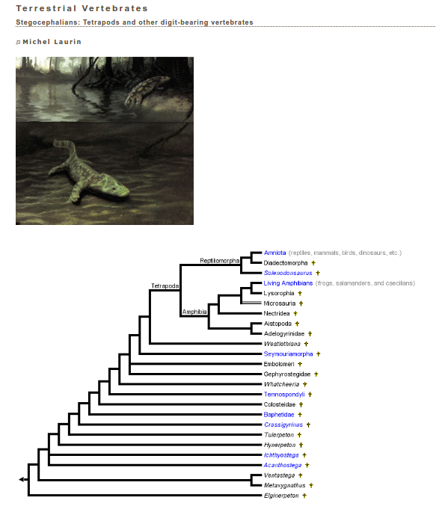
It is difficult to visualize large trees Multi-page approaches are not convenient
www.tolweb.org

Slide 17
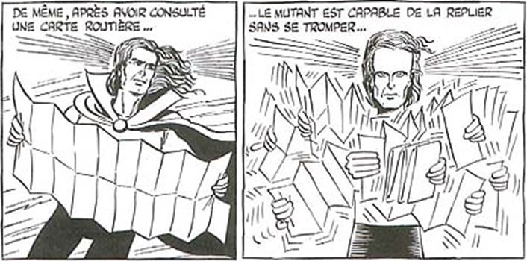
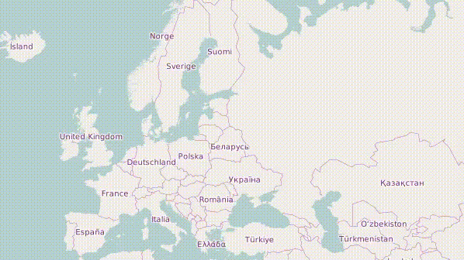
The ‘revolution’ in tree visualization parallel with cartography
Deep-zooming
Gotlib, 1996, Rubrique-à-Brac, tome 2
Suggested by Westneat (2009)
and Page (2012) for trees

Slide 18
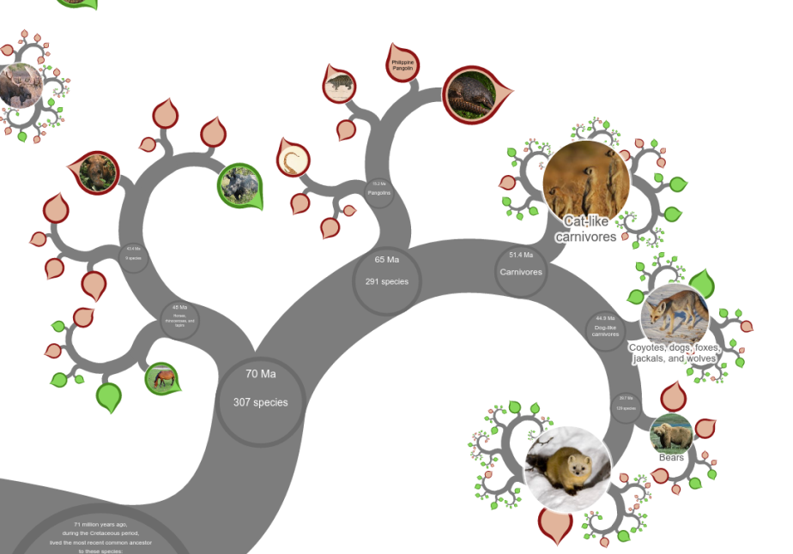
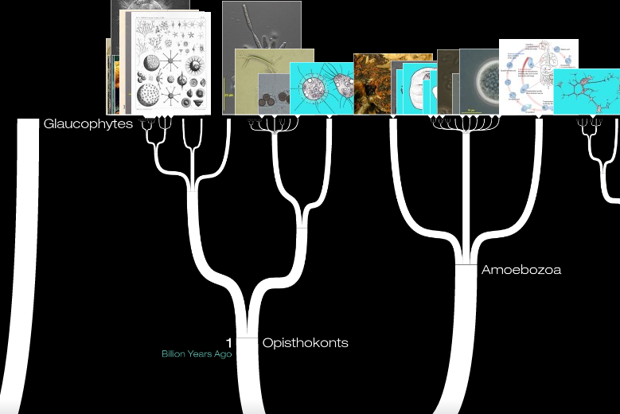
The ‘revolution’ in tree visualization
OneZoom
Rosindell and Harmon, 2012
DeepTree
Block et al., 2012
Only for education / communication purpose (not a tool for researchers)
No multifurcations
(80% of the nodes in the ToL)
Easy to get lost
Limited number of species
(70 000 vs 2 Million in the ToL)
Lots of computation while navigating
Fixed (unique) tree
Cannot handle more than 400,000 species

Slide 19
The ‘revolution’ in tree visualization
OneZoom
Rosindell and Harmon, 2012
DeepTree
Block et al., 2012
Only for education / communication purpose (not a tool for researchers)
No multifurcations
(80% of the nodes in the ToL)
Easy to get lost
Limited number of species
(70 000 vs 2 Million in the ToL)
Lots of computation while navigating
Fixed (unique) tree
Cannot handle more than 400,000 species

Slide 20
The need for a new visualization
No limitation in the amount of data (# species)
Smooth and fast
Allow multifurcations
Tree-looking
Links to additional resources
Serve as a background for additional information (as layers)
Possibility to visualize your own trees
For large public, education and research

Slide 21
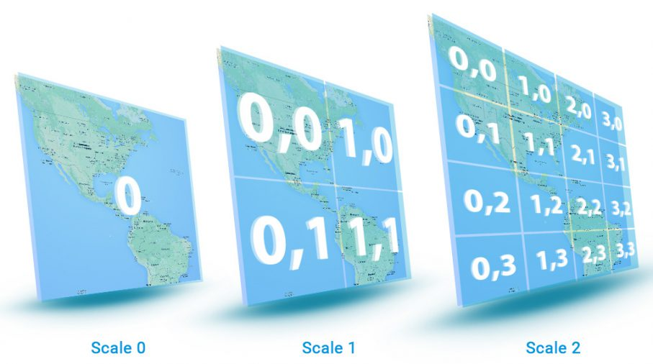
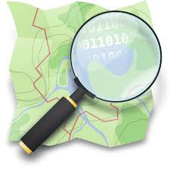
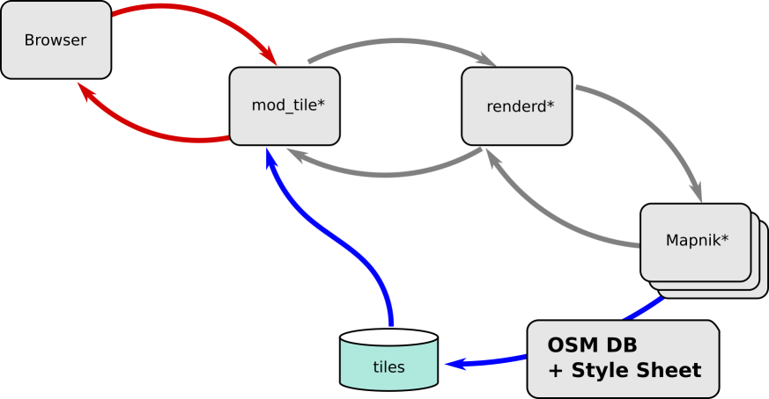
The need for a new visualization
No limitation in the amount of data (# species)
Smooth and fast
Allow multifurcations
Tree-looking
Links to additional resources
Serve as a background for additional information (as layers)
Possibility to visualize any user’s tree
For large public, education and research
OpenStreetMap

Slide 22
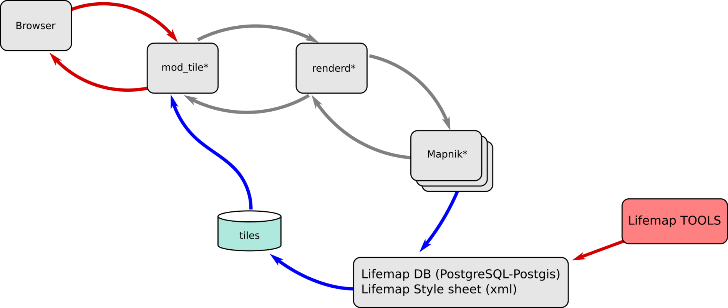
The need for a new visualization
No limitation in the amount of data (# species)
Smooth and fast
Allow multifurcations
Tree-looking
Links to additional resources
Serve as a background for additional information (as layers)
Possibility to visualize any user’s tree
For large public, education and research

Slide 23
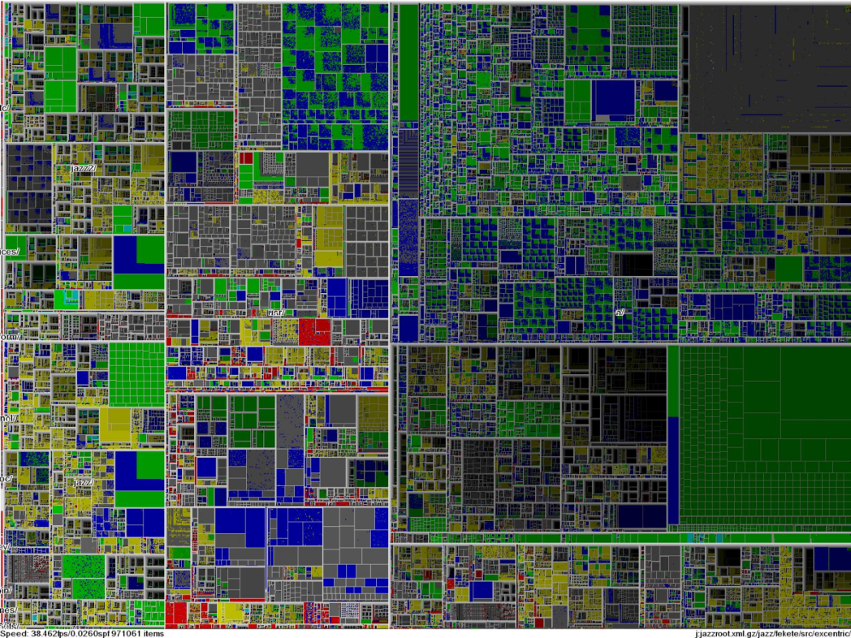
The need for a new visualization
No limitation in the amount of data (# species)
Smooth and fast
Allow multifurcations
Tree-looking
Links to additional resources
Serve as a background for additional information (as layers)
Possibility to visualize any user’s tree
For large public, education and research

Slide 24
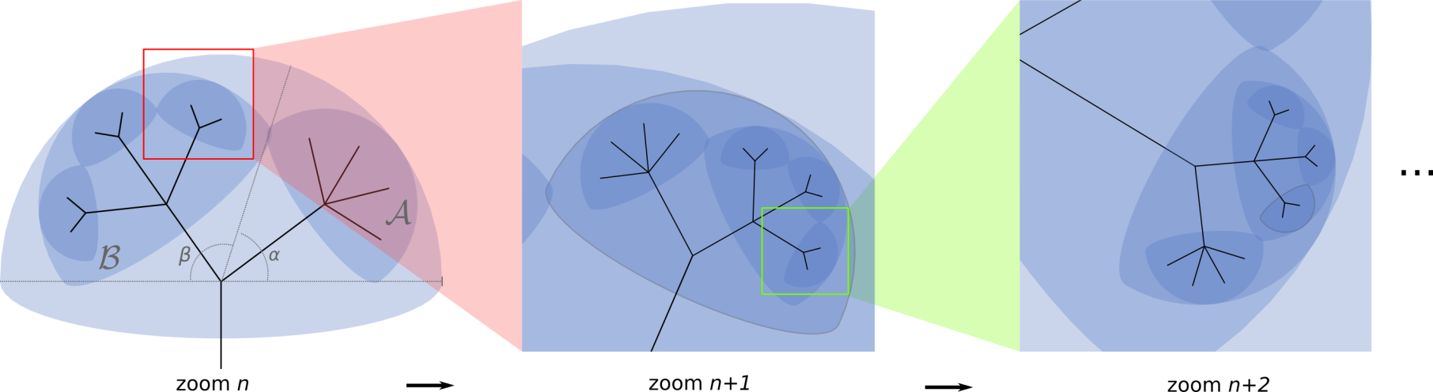
The need for a new visualization
No limitation in the amount of data (# species)
Smooth and fast
Allow multifurcations
Tree-looking
Links to additional resources
Serve as a background for additional information (as layers)
Possibility to visualize any user’s tree
For large public, education and research

Slide 25
Lifemap tools / pipeline
Get the tree (NCBI, OTOL, any tree)
Traverse the tree
Compute coordinates of all elements at all zoom levels
Get additional information for nodes and tips
Write in PostgreSQL/PostGIS database
Write in Solr Search Engine

Slide 26

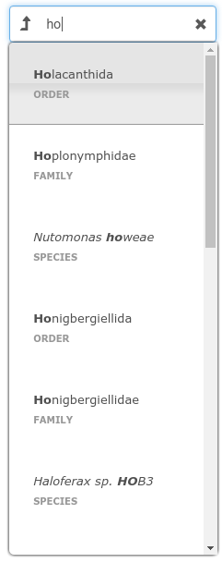

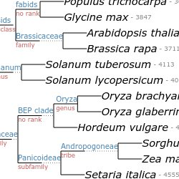
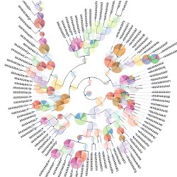
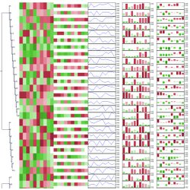
Lifemap tools / pipeline
Get the tree (NCBI, OTOL, any tree)
Traverse the tree
Compute coordinates of all elements at all zoom levels
Get additional information for nodes and tips
Write in PostgreSQL/PostGIS database
Write in Solr Search Engine
Huerta-Cepas et al. 2016

Slide 27
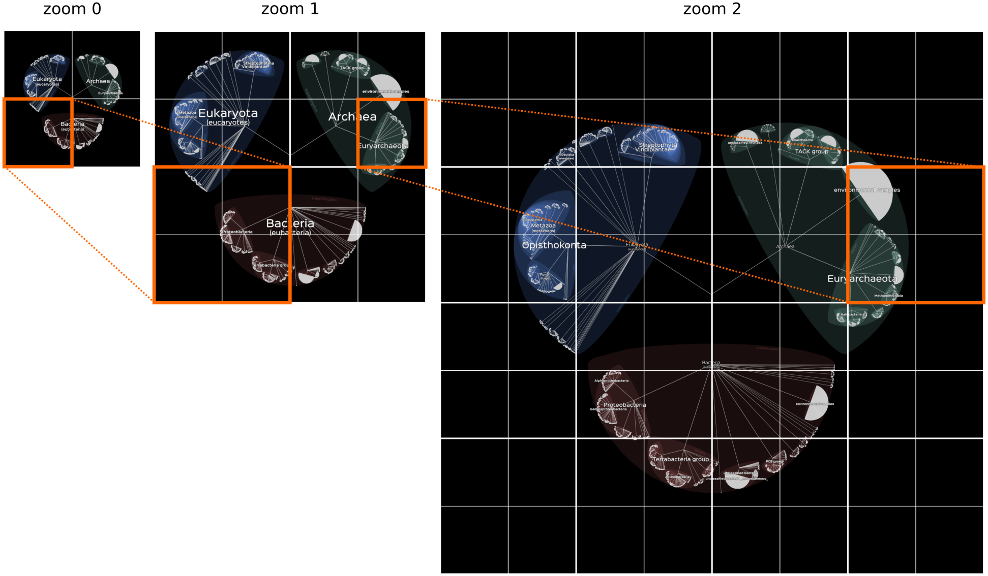
Lifemap

Slide 28



The need for a new visualization
No limitation in the amount of data (# species)
Smooth and fast
Allow multifurcations
Tree-looking
Links to additional resources
Serve as a background for additional information (as layers)
Possibility to visualize your own trees
For large public, education and research
3 Lifemap versions

Slide 29
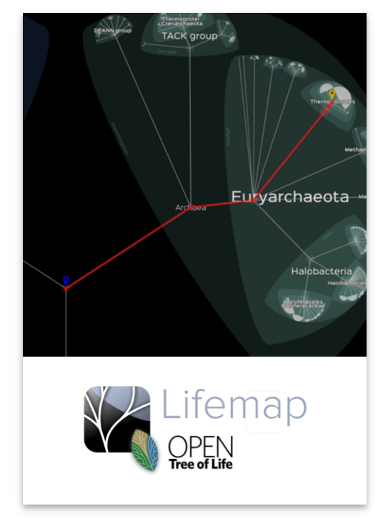
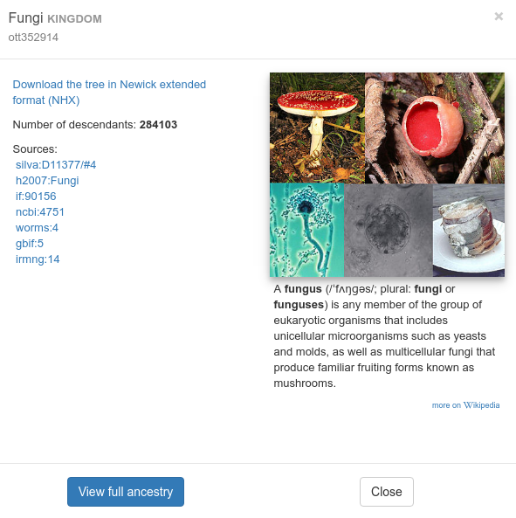
Three versions of Lifemap
Complete ‘open tree of life’ (2 131 472 tips)
52 zoom levels to go to the deepest tip
Additional
information:

Slide 30
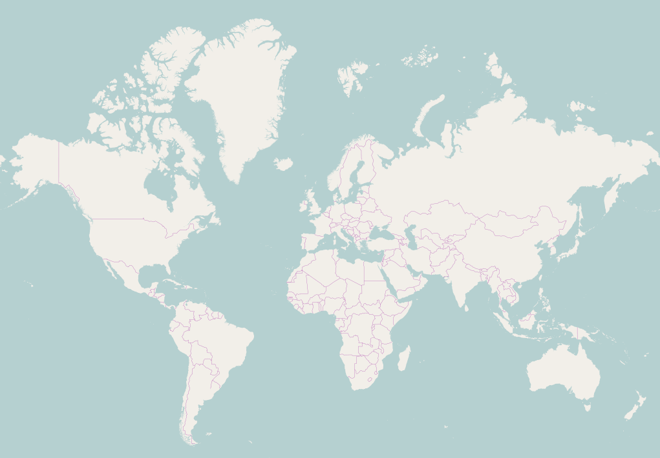
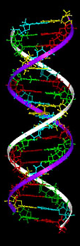
Three versions of Lifemap
52 zoom levels
Complete ‘open tree of life’ (2 131 472 tips)
52 zoom levels to go to the deepest tip
Additional
information:
40 000 km
2 nm

Slide 31
Three versions of Lifemap
Complete ‘open tree of life’ (2 131 472 tips)
52 zoom levels to go to the deepest tip
Additional
information:

Slide 32
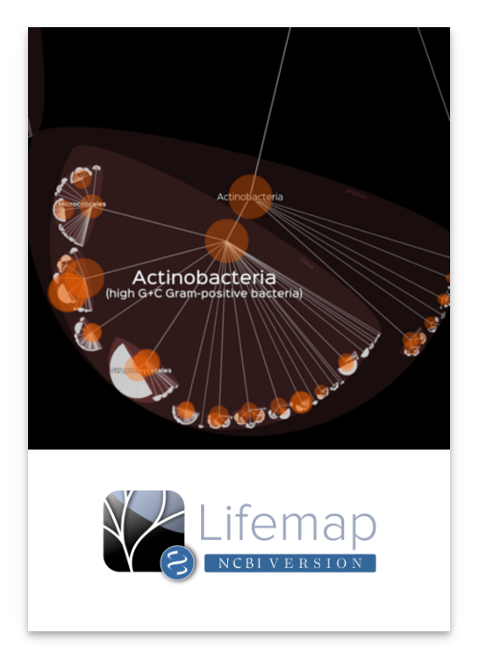
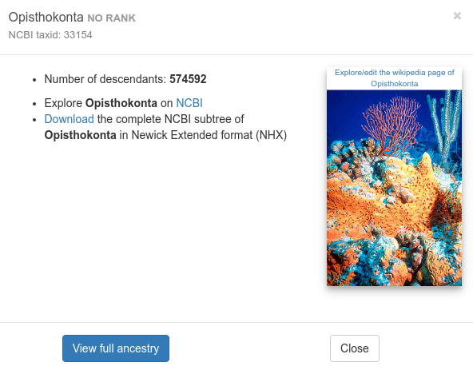
Three versions of Lifemap
Full NCBI taxonomy (1 220 620 tips)
32 zoom levels to go to the deepest tip
Updated monthly (last update on Tuesday)
Additional
information:

Slide 33
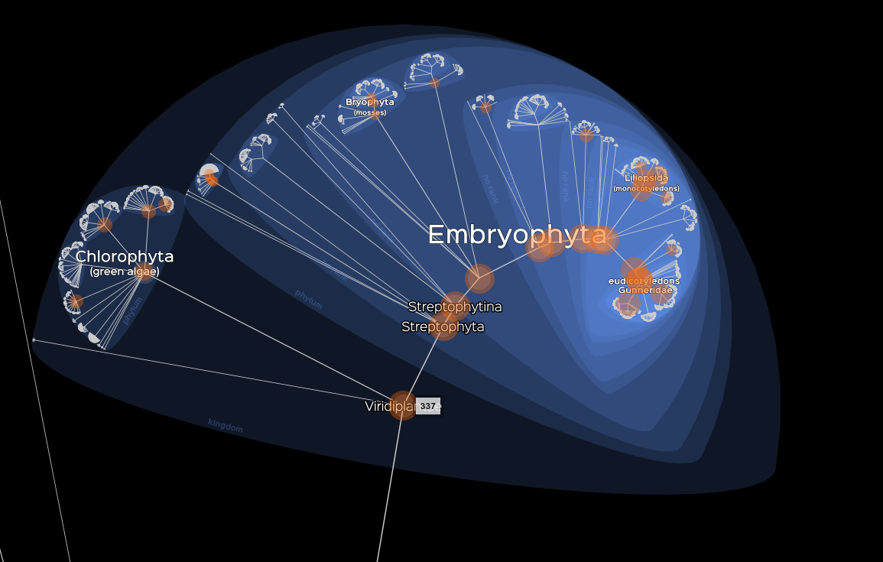

Three versions of Lifemap
Full NCBI taxonomy (1 220 620 tips)
32 zoom levels to go to the deepest tip
Updated monthly (last update on Tuesday)

Slide 34
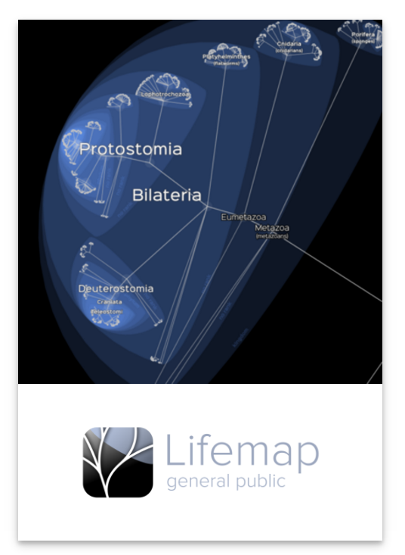
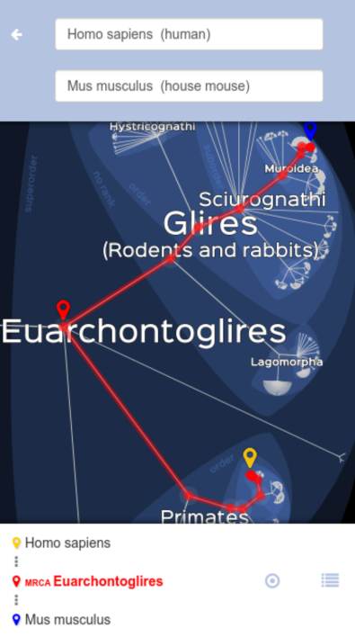
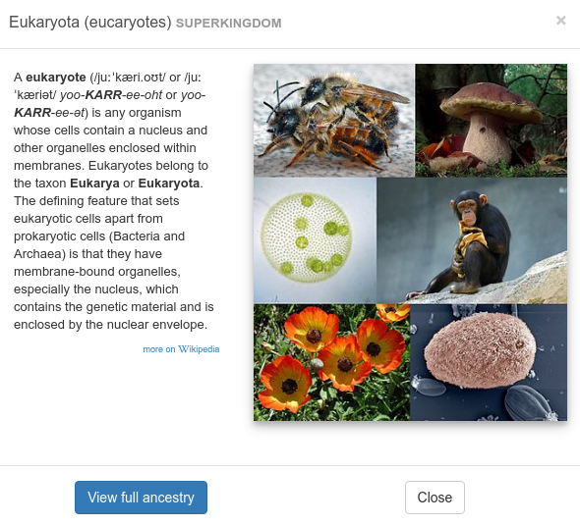
Three versions of Lifemap
Simplified NCBI taxonomy (802639 tips)
Removed subspecies level as well as ‘unidentified’,
‘environmental’, ‘unclassified’, ‘uncultured’ taxa.
26 zoom levels to go to the deepest tip
Additional
information:

Slide 35
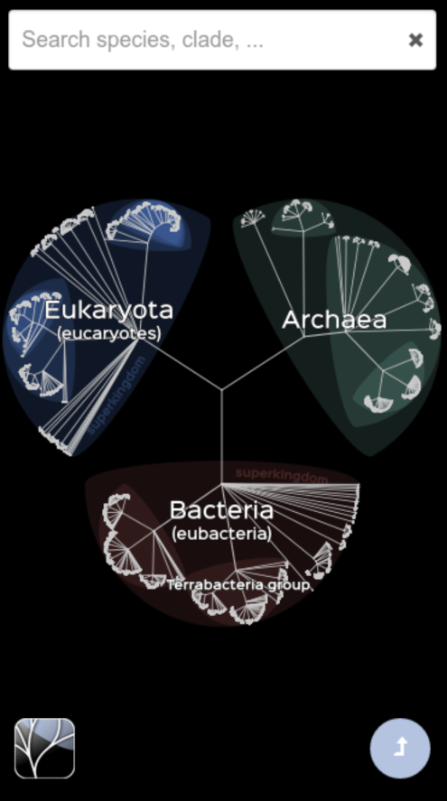
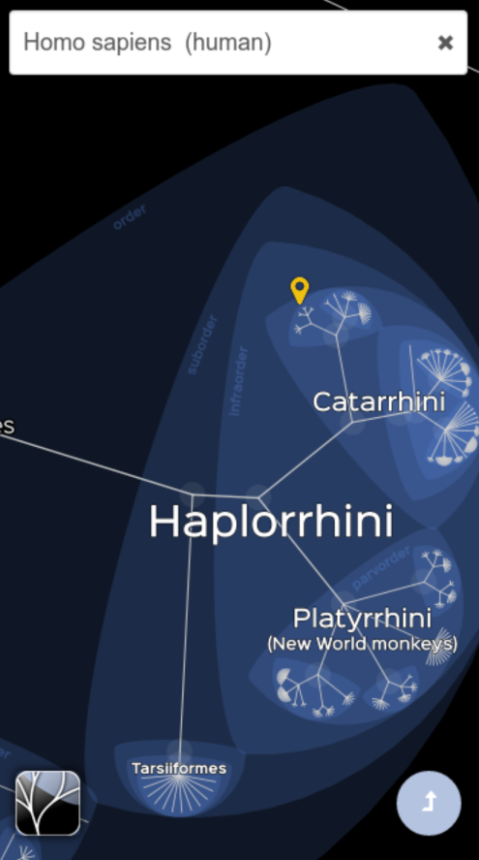
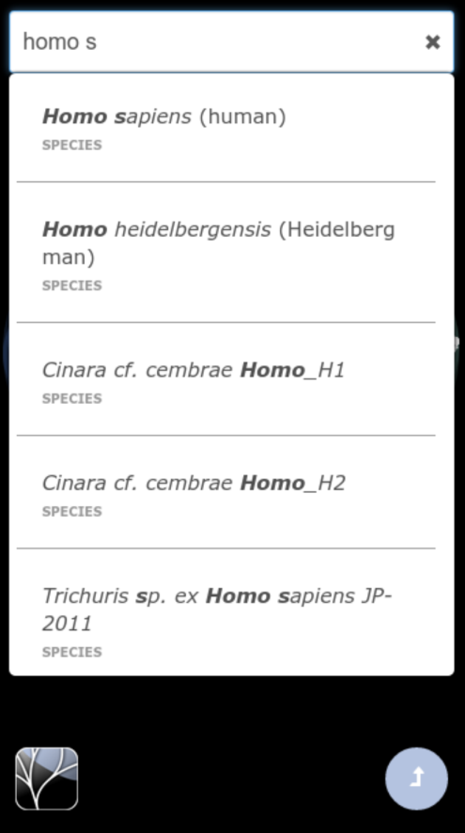
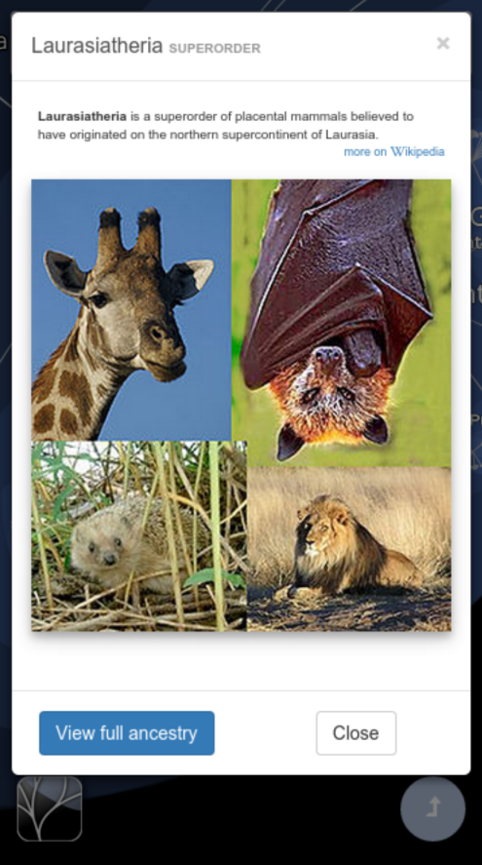



Three versions of Lifemap
Simplified NCBI taxonomy (802639 tips)
--soon--

Slide 36

And a version to visualize your own trees
http://lifemap.univ-lyon1.fr/download.html
Upload your own (Newick) trees
Nodes are named automatically if necessary
Explore the tree, search nodes and tips with an efficient search tool (Solr)

Slide 37
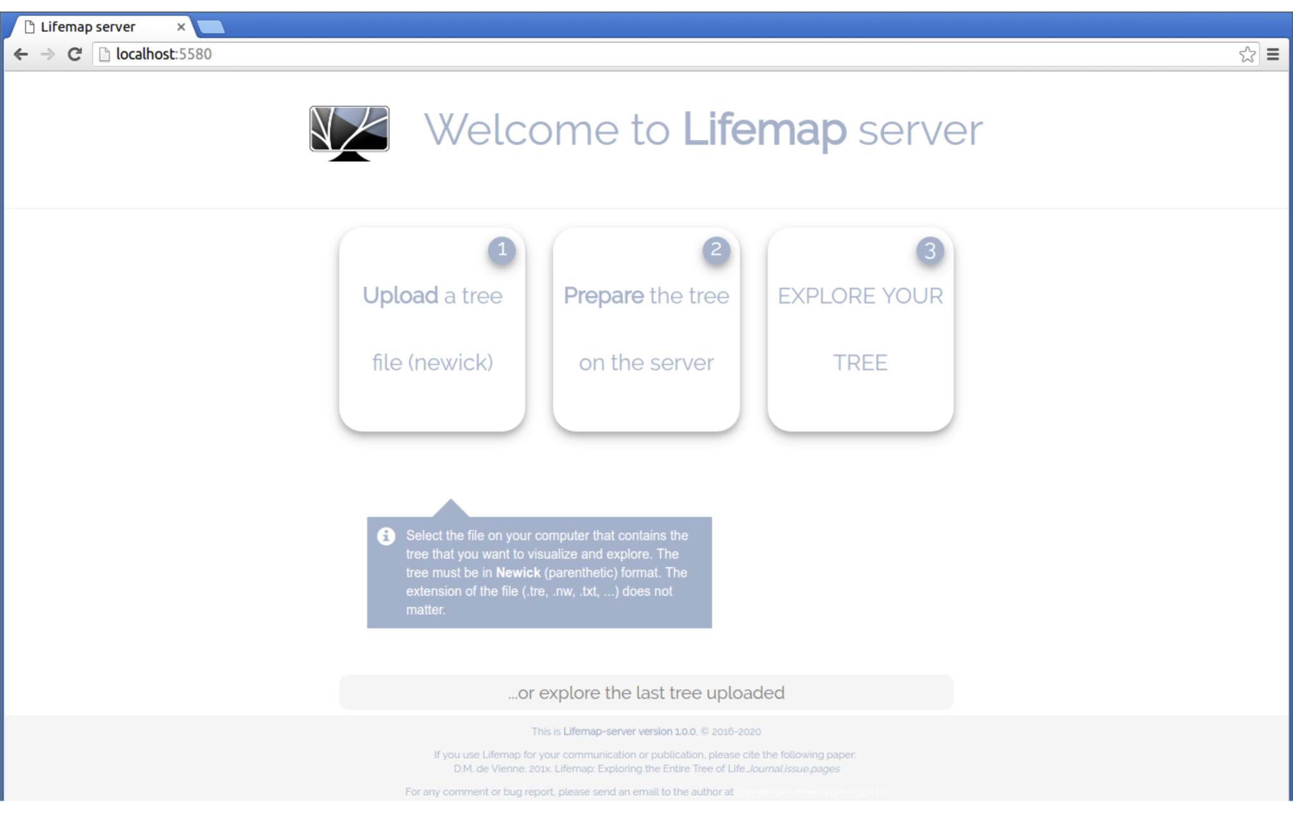

Slide 38
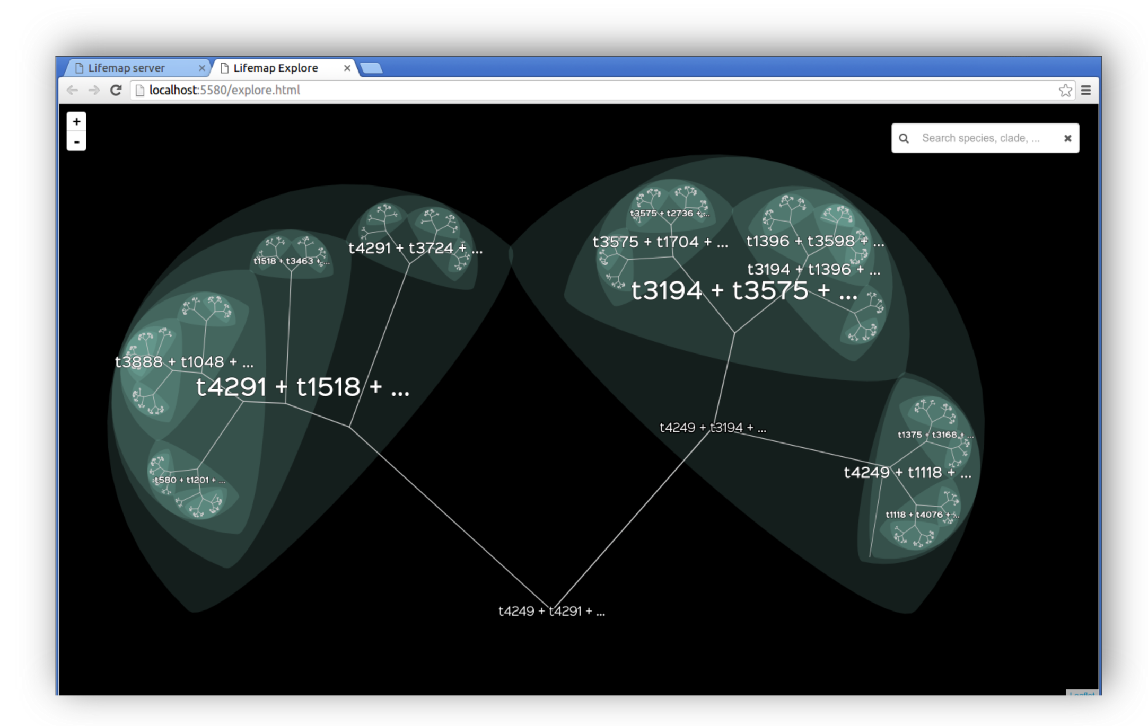

Slide 39
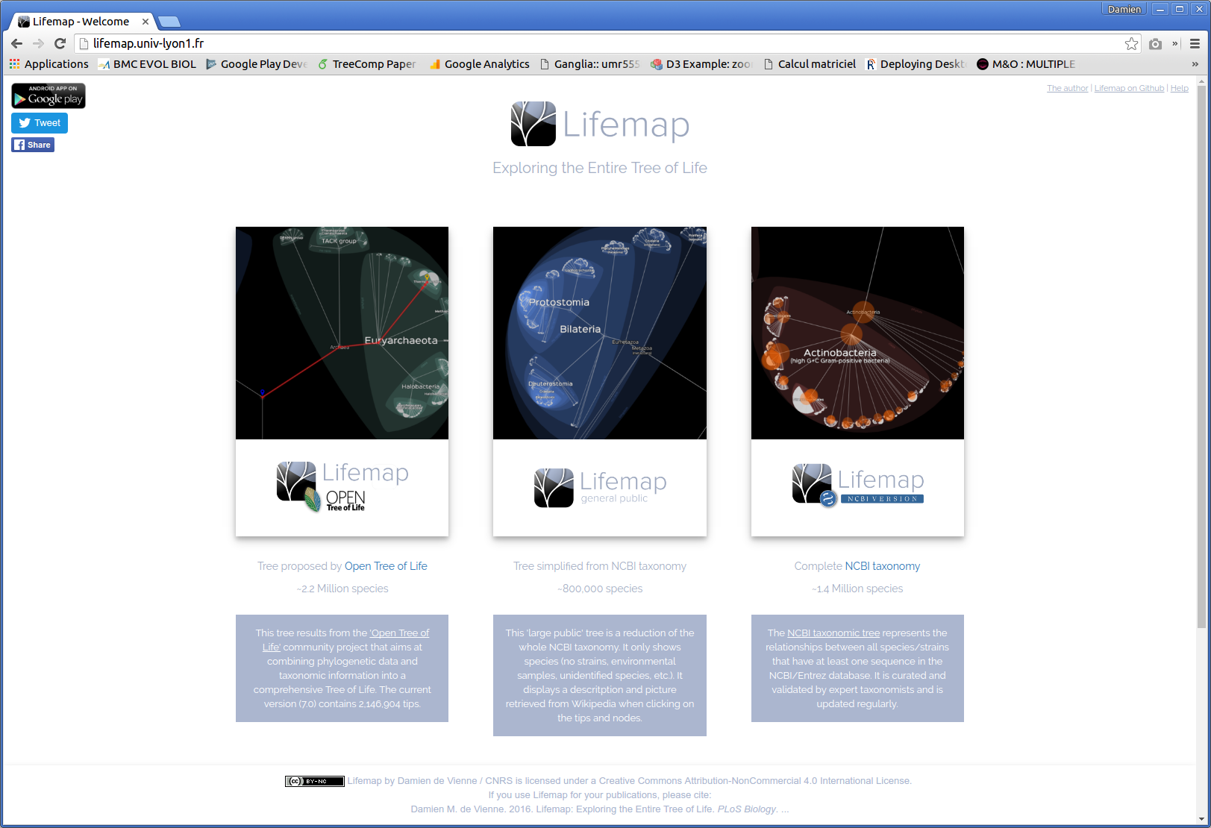
http://lifemap.univ-lyon1.fr

Slide 40
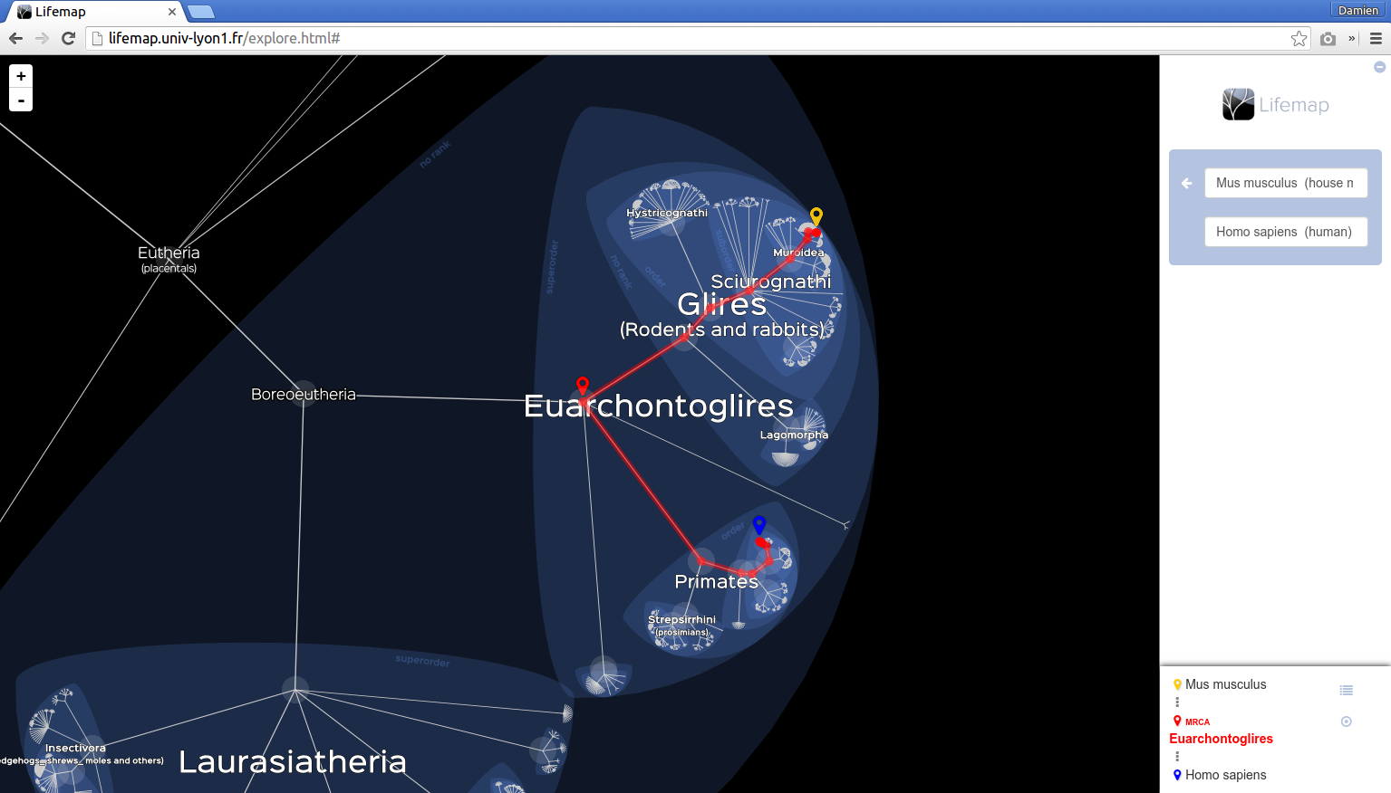

Slide 41


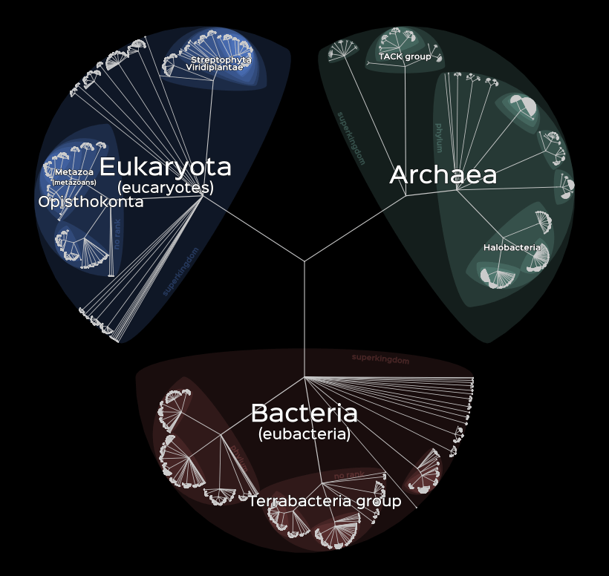



Thanks
Stéphane Delmotte
Try it
Use it
Share it
Suggest improvements
Bruno Spataro

